Slide 1
ASIS Academy
Automation by Scripting
Adam Shackleton

Slide 2
Course Agenda
1. Introduction to Python
- What is scripting; Why Python; Lighting Python lesson
2. Introduction to Automation
- What do we mean by automation; Interacting with files and the file system
3. APIs
- What’s an API; How to access them using Python
4. Databases
- Lighting SQL lesson; Creating and using database connections
5. Excel Files
- Pandas; Common Excel functions in Python

Slide 3
Today’s Agenda
Python tasks
Review of last week’s content
Virtual environments
Introduction to databases
SQL vs NoSQL
Lightning SQL intro
More Python tasks
Database access libraries
Making SQL calls to a database
Further reading
Code challenge
Notes:
If you have questions throughout please put them in the chat and if anyone knows the answer they’re welcome to help me out, otherwise I’ll sweep them up before we go into the exercises
This isn’t a Python course – it’s a course about using python so the pace might be a bit fast – rest assured all the code I show as examples will be available when you’re working on the exercises

Slide 4


Tools we’ll use during our sessions
Python 3.10
VS Code
https://www.python.org/
https://code.visualstudio.com/
Notes:
This presentation and all the code I show is in the github repo I’ve shared in the chat

Slide 5
Last week recap

Slide 6
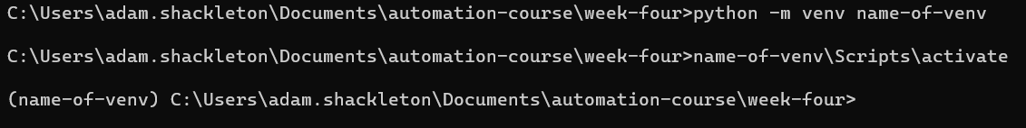
Python – Virtual Environments
When installing third party libraries, it’s good practice to store them separate to your main Python installation.
Instead, we create a temporary or “virtual” environment which we install new libraries into.
This allows us to have multiple versions of the same library if needed for different projects.
We create virtual environments from the Windows command line.
Once created, we need to activate our new environment using <name>\Scripts\activate.
After which we can install libraries using pip. Visual Studio Code will recognise your virtual environment installation.

Slide 7

Databases
Databases hold an organised structured set of data and are (usually) controlled by a database management system (DBMS)
There are two main types – file based and client-server.
Most databases have a GUI that can be used to access and update them, but they also have a language that can be used for common tasks
Notes:
File based databases are what they sound like – literally a file that gets saved in the file system and the gui / code updates
server- based databases typically have their own services and are “running” all the time, these are much more common in production

Slide 8
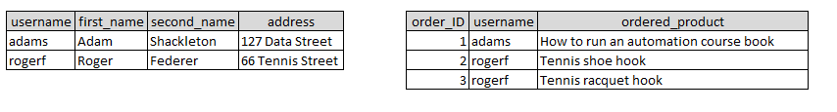
SQL and NoSQL
Traditional database are usually referred to as “relational”. They have tables, often hundreds of them, each of which hold a set of data that is unique.
These tables will have relationships that are recorded in the metadata of the table
The query language that is used to access and manipulate data in these types of database is called Structured Query Language or SQL
Examples of SQL databases are: SQLite, MySQL, Oracle, MS SQL Server, PostgreSQL, DB2
The other type of database does not enforce these table structures or defined relationships and does not use SQL. They are unstructured and designed for scaling out rather than up and are very good at that.
Some examples include: MongoDB, CouchDB, DynamoDB
Notes:
Sequel or S–Q-L, you decide, but it’s sequel

Slide 9



SQL – Selecting data
The most basic of SQL queries simply states the columns you want data from, and the table those columns are in using the SELECT and FROM key words:
If you want to filter those results, you can use the WHERE clause:
If you want to retrieve data that spans two tables, you JOIN those tables together based on a common column. When you refer to columns in each table, you use dot.notation to specify the table and column
Notes:
Sequel or S–Q-L, you decide, but it’s sequel

Slide 10
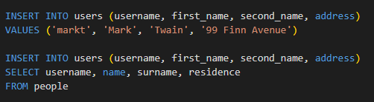


SQL – Inserting, updating, and deleting data
To add records to an existing table, we use the INSERT statement, this can be done by adding specific values, or by selecting some data from another table.
If you want to update some date, use and UPDATE statement
Delete data with a DELETE statement (no need to specify columns here as the whole row is always deleted)
Notes:
Sequel or S–Q-L, you decide, but it’s sequel

Slide 11
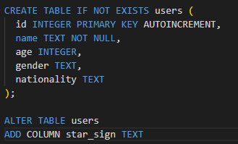
SQL – Creating databases and tables
Generally speaking, you can’t create a database from Python (SQLite is an exception to this), for MySQL or PostgreSQL or most others you have to set up the database in advance before you can access it.
Once that’s done however, everything else can be done with SQL.
SQLite has pretty limited options for manipulating existing tables, but other databases have much more options
Notes:
Sequel or S–Q-L, you decide, but it’s sequel

Slide 12

Accessing databases with Python
To interact with the DBMS, we need a library specific to the DBMS we’re using.
SQLite has a python library included in the standard library, but for any other database you’re likely to have to install one from pip
For these sessions we’ll be using SQLite as everyone already has it with their python installation
Three steps to be aware of:
The first thing to do is create a connection object
That connection object has a cursor, this is the thing that executes your query
Once a query is executed the connection must either commit the action, or fetch the result

Slide 13
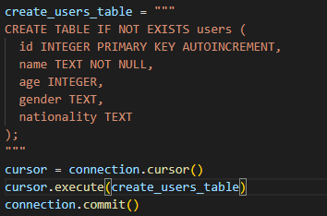
Accessing databases with Python
Setup a connection to our SQLite database, if it doesn’t exist already, this will create it
Create a table in the database

Slide 14
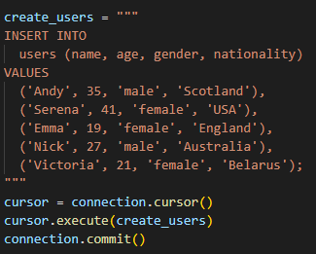
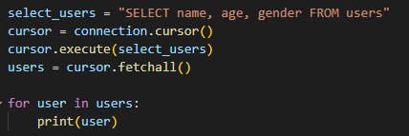
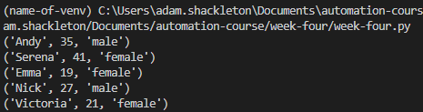
Accessing databases with Python
Populate the table with some data
Select that data back and print it out

Slide 15
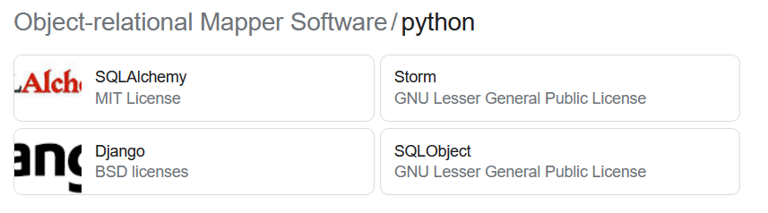
Further reading – Object-relational Mapper
Think of an ORM as the SDK of databases.
It abstracts the actual SQL statements into more python-friendly objects.
Allows developers to write Python rather than SQL in order to select, update, delete, or insert data into tables.
This is particularly useful if you are going to use different databases in a development and production environment which would otherwise require different SQL syntax depending on the environment.

Slide 16
Thank You

Slide 17
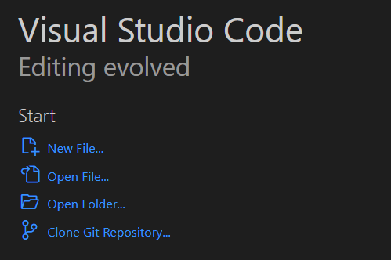
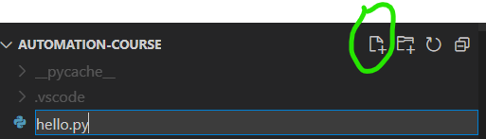
Checking it’s working – Hello World
Once Python and VS Code are installed, create a folder to hold your code and then open VS Code
When it opens, click Open Folder… and select your desired location
From the Explorer, click the new file icon and call it hello.py

Slide 18
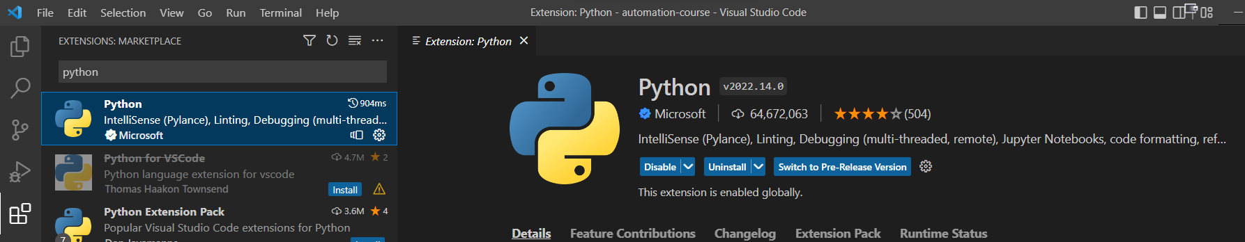
Checking it’s working – Hello World
There’s a good chance VS Code will recognise that you are running a python file and ask you to install the python extension, if not, go to the Extensions icon and search for it
Click the blue install button (shows as “Uninstall” in my screenshot)

Slide 19
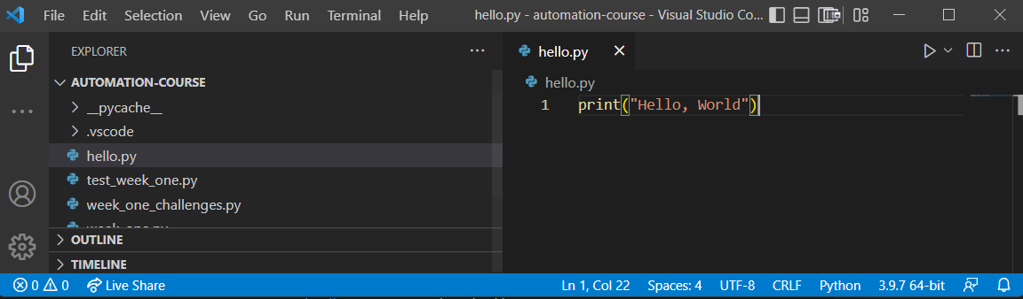
Checking it’s working – Hello World
Once that’s done, go to your hello.py file and type print(“Hello, World”)
Check that VS Code has recognised you have a Python interpreter, shown here as 3.9.7, and click the play button in the top right corner

